Slide 1
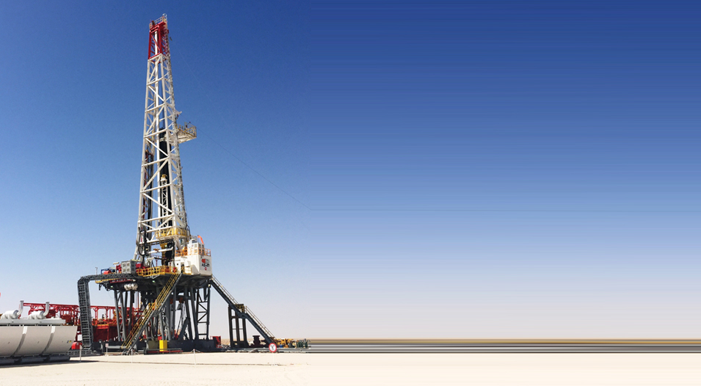

SCHLUMBERGER CASE STUDY
Presented By:-
Pragati Singh
Vishnu Kant Verma
Debayan Sengupta

Slide 2


WORKFLOW IN OUR PRESENTATION
FIND THE RESERVOIR(S) DEPTH IN THE WELL LOGS???
FIND POROSITY, SATURATION OF WATER AND PERMEABILTY.

Slide 3
INTEPRETATION
FACIES MODELLING
NET TO GROSS PAY

Slide 4
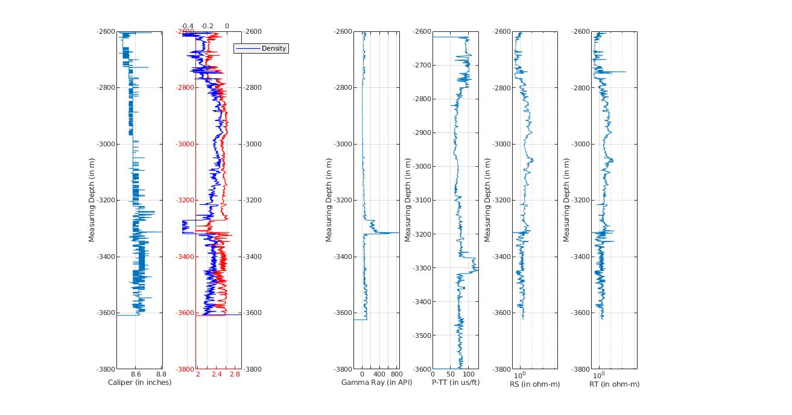
WELL “1”
DENSITY
FORMATION”A”
FORMATION “B”
FORMATION “C”
NPHI

Slide 5
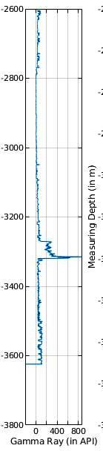
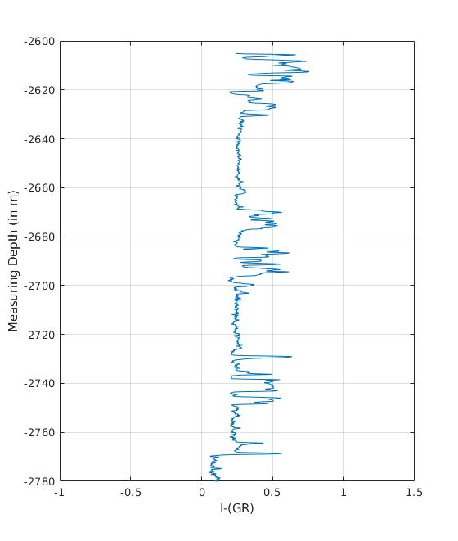
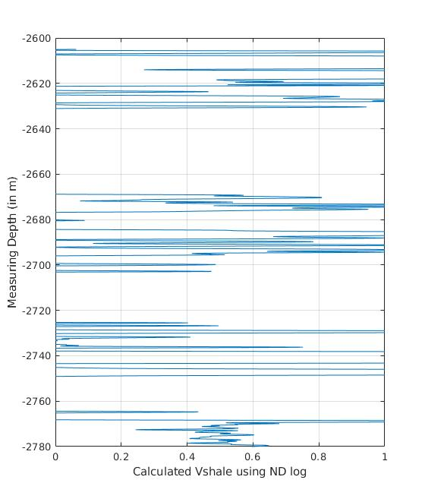
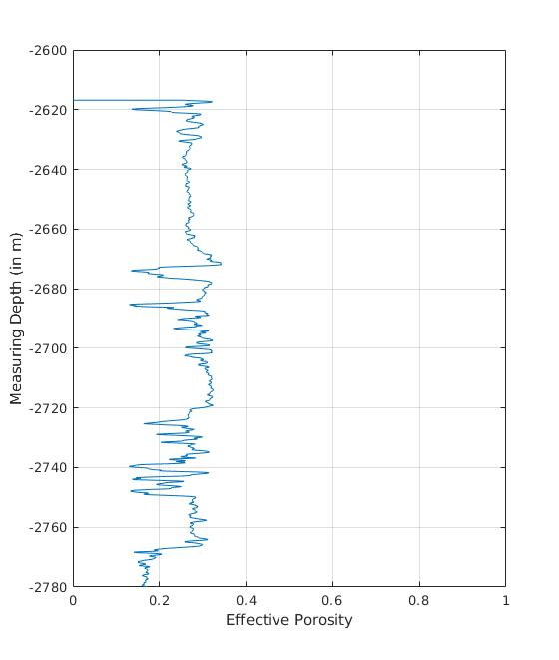
FORMATION “A”
FORMATION “A”
EFFECTIVE POROSITY
LOOKING AT THE FORMATION “A” FOR WELL 1

Slide 6
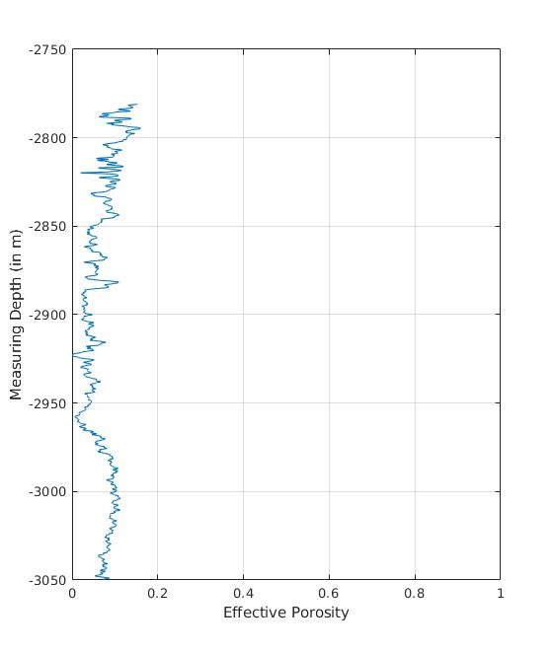
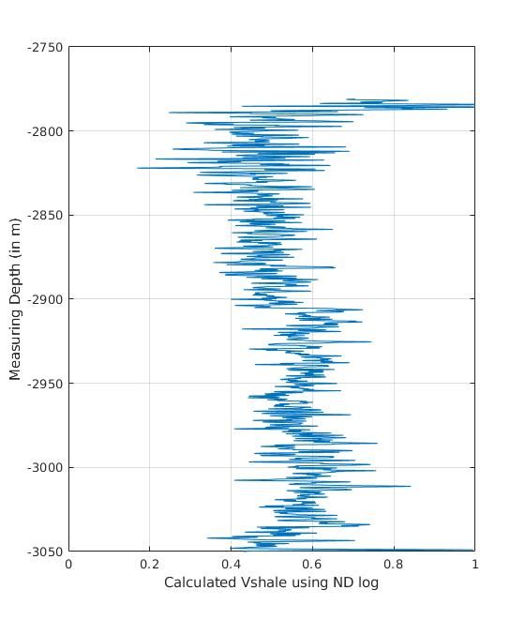
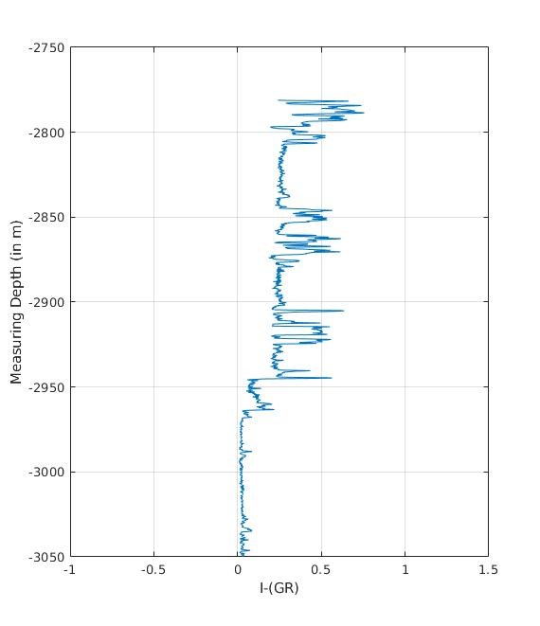
LOOKING AT THE FORMATION “B” FOR WELL 1

Slide 7
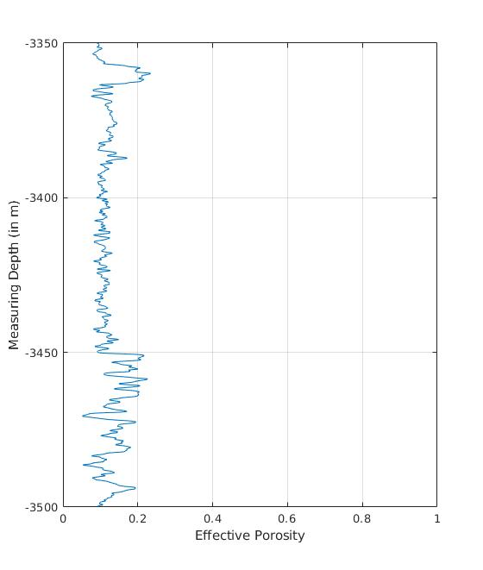
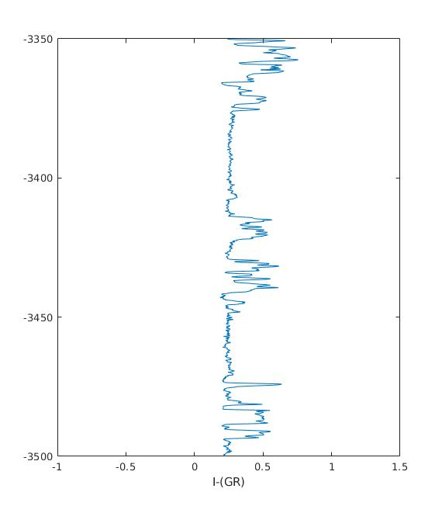
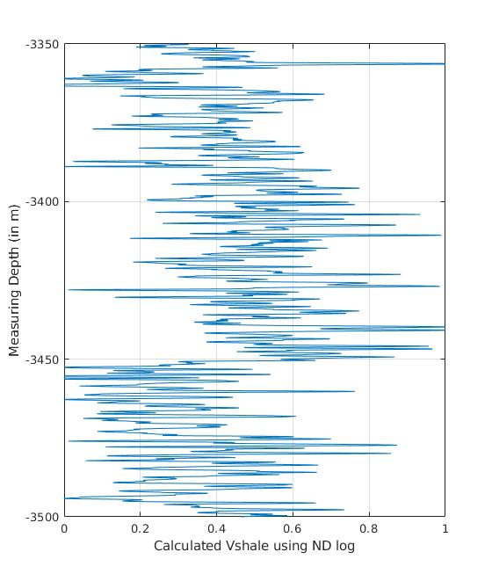
LOOKING AT THE FORMATION “C” FOR WELL 1

Slide 8
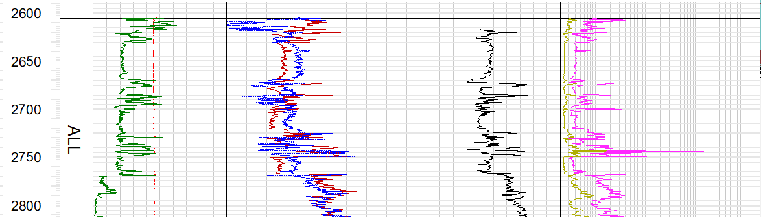
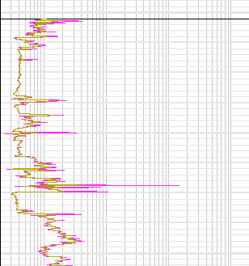
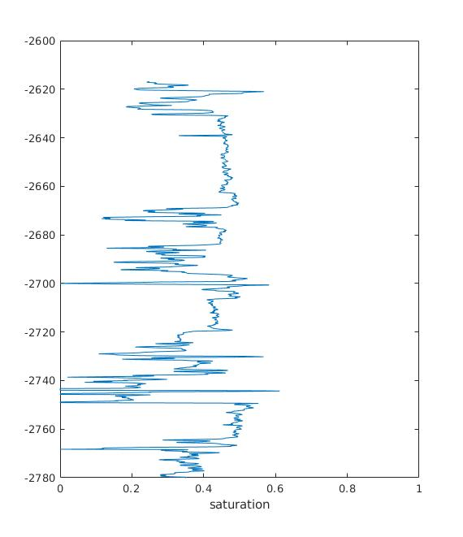
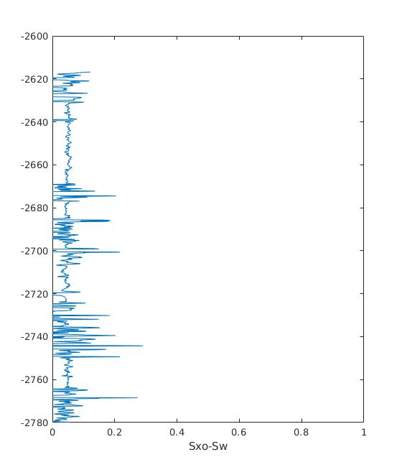
GAMMA LOG ((API)
0.46
N-D LOG
-0.16
SONIC LOG(μs/ft)
RESISTIVITY LOG
0
150
150
240
40
DENSITY
OHM-m
FORMATION “A”
FORMATION “A”
NPHI
FORMATION “A”
FORMATION “A”
INTERCALATED SANDSTONE AND SHALE UNITS
DEPTH(m)
PERMEABILITY
FORMATION “B”
FORMATION “B”
SATURATION OF
WATER
Rt
DENSITY
(g/cc)
Rs
1.9
2.9
0.2
2000
NPHI

Slide 9
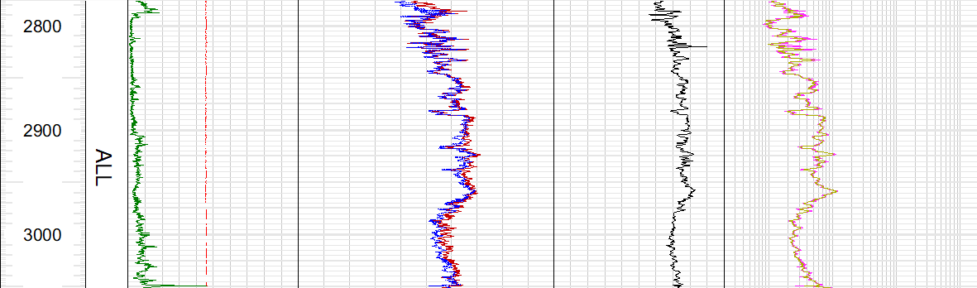
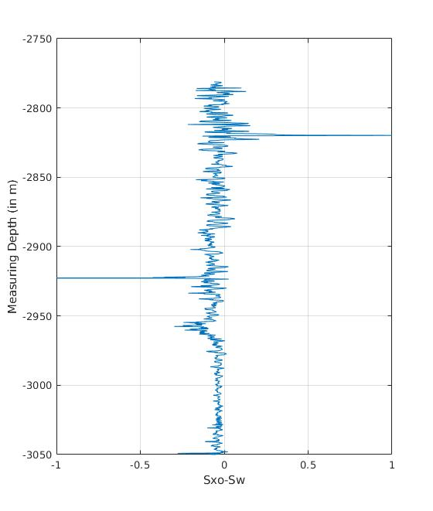
GAMMA LOG ((API)
N-D LOG
SONIC LOG(μs/ft)
RESISTIVITY LOG(OHM-m)
150
0.46
-0.16
240
40
0
PERMEABILITY
Rs
DENSITY
(g/cc)
Rt
DEPTH(m)
EVAPORITES
FORMATION B
FORMATION “B”
NPHI
1.9
2.9
0.2
2000
NPHI

Slide 10
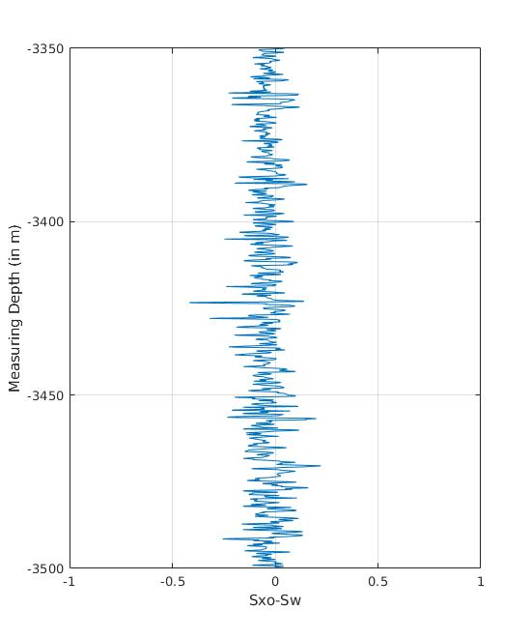
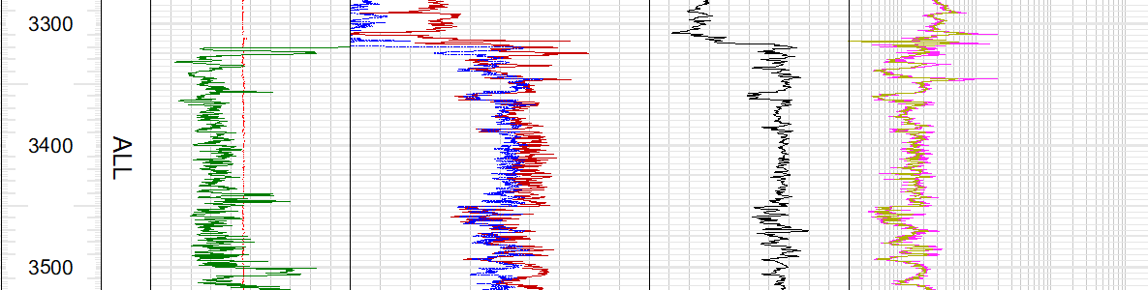
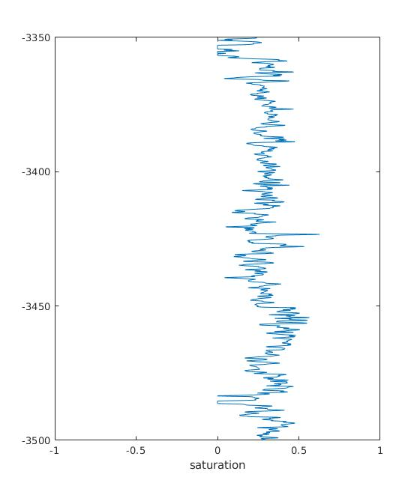
GAMMA LOG ((API)
N-D LOG
SONIC LOG(μs/ft)
RESISTIVITY LOG(OHM-m)
INTERCALATION OF SANDSTONE AND SHALE
DEPTH(m)
PERMEABILITY
DENSITY
SATURATION OF WATER
INTERCALATION OF SANDSTONE AND SHALE
FORMATION “C”
NPHI

Slide 11
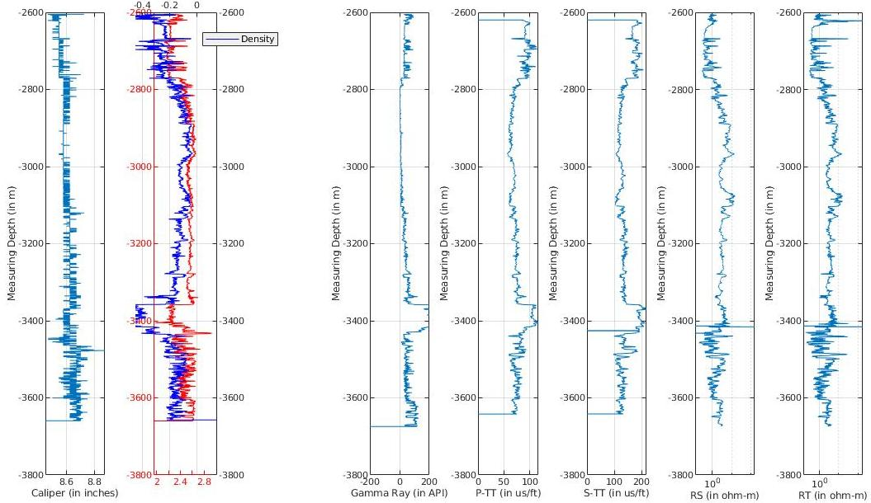
DENSITY
FORMATION “A”
Formation “B”
FORMATION “C”
NPHI
WELL “2”

Slide 12
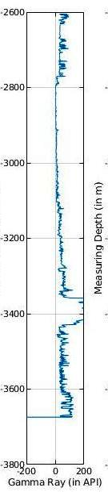
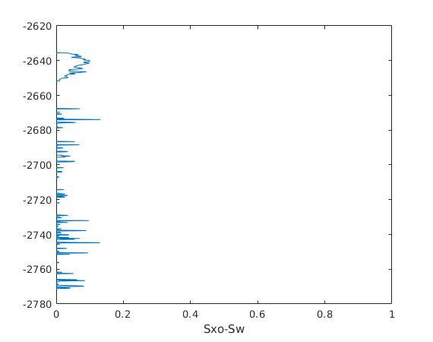
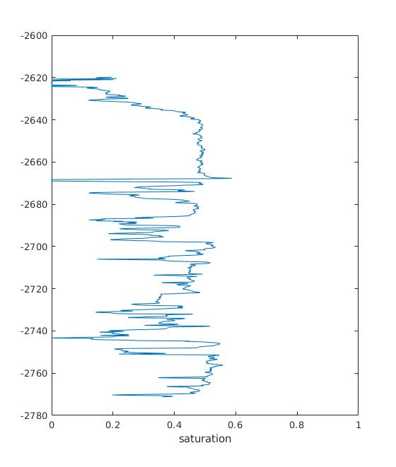
V_shale
PERMEABILITY
FORMATION “A” OF WELL 2 IS CORRELATABLE WITH FORMATION “A” OF THE WELL 1.

Slide 13
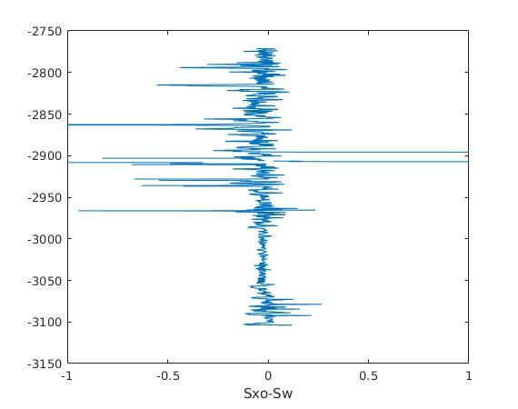
V_shale
PERMEABILITY
LOOKING AT THE FORMATION “A” FOR WELL 2

Slide 14
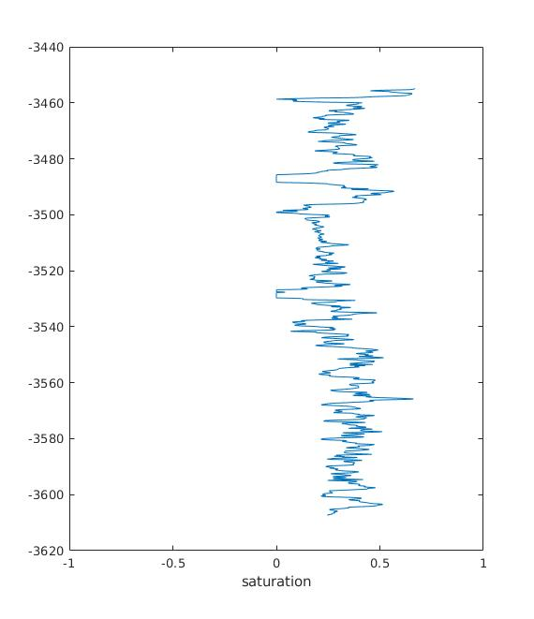
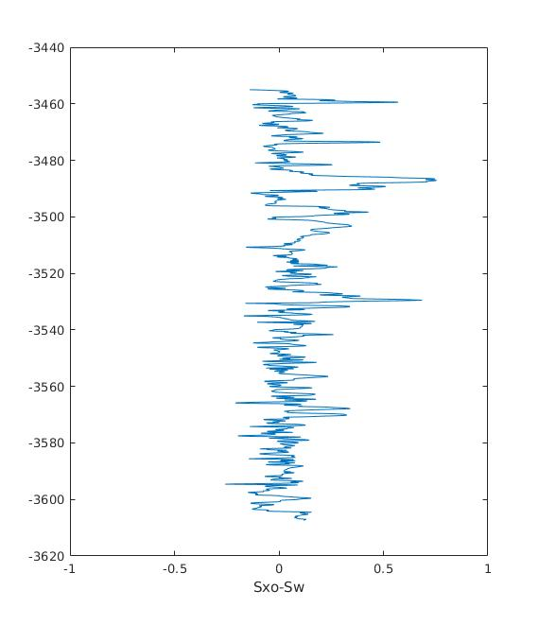
SATURATION OF WATER
V_shale
PERMEABILITY
LOOKING AT THE FORMATION “C” FOR WELL 2

Slide 15
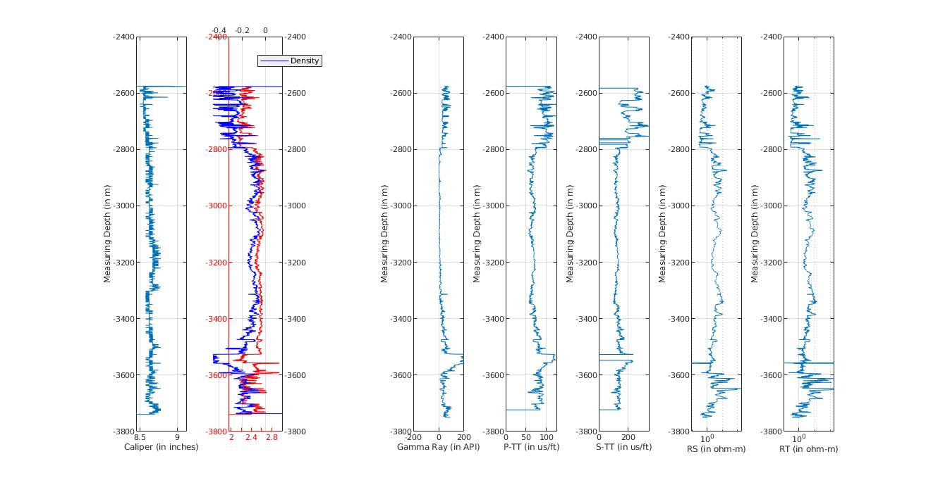
WELL “3”
DENSITY
FORMATION “A”
FORMATION“B”
FORMATION “C”
NPHI

Slide 16
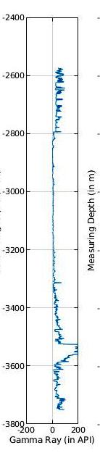
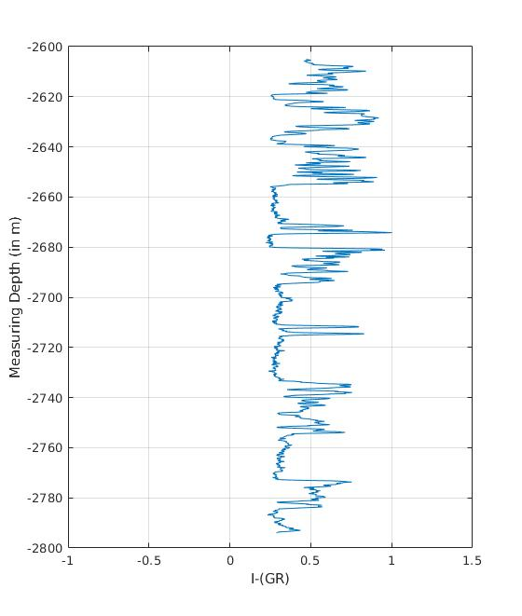
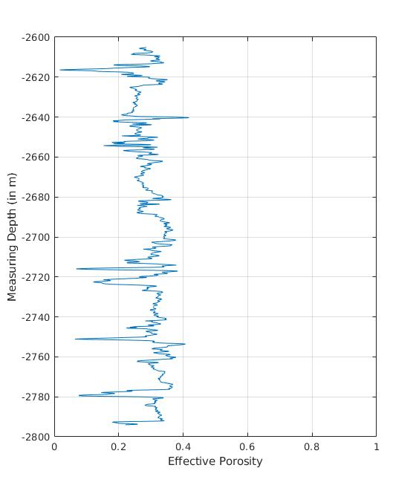
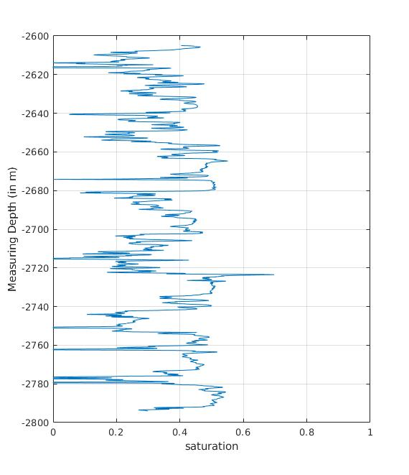
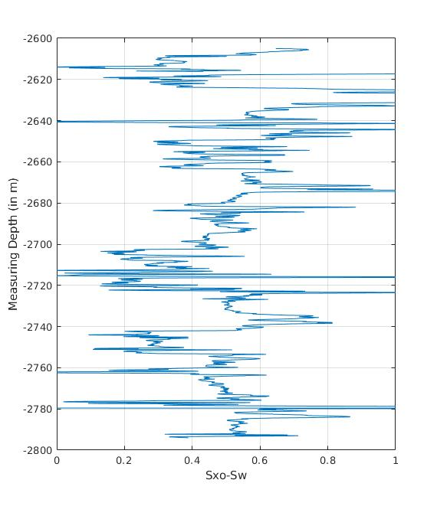
Effective porosity
Sw-Saturation
V-Shale
Permeability
LOOKING AT THE FORMATION “A” FOR WELL 3

Slide 17
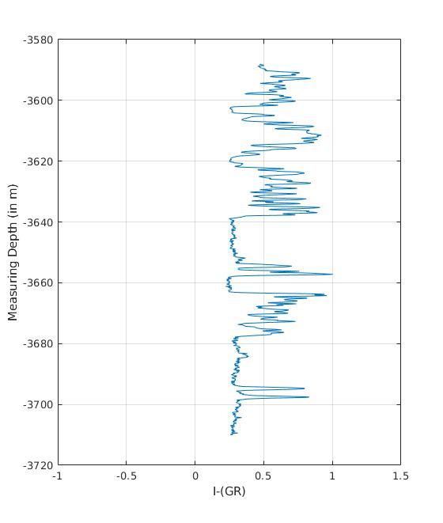
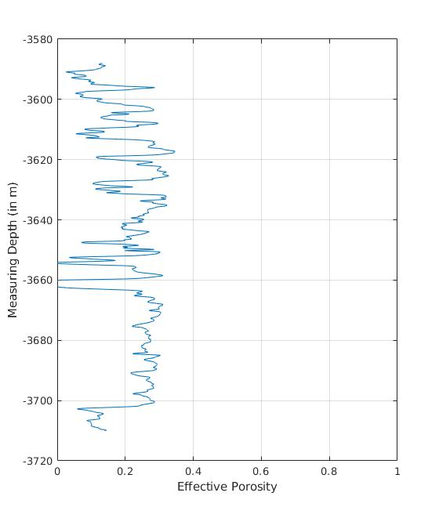
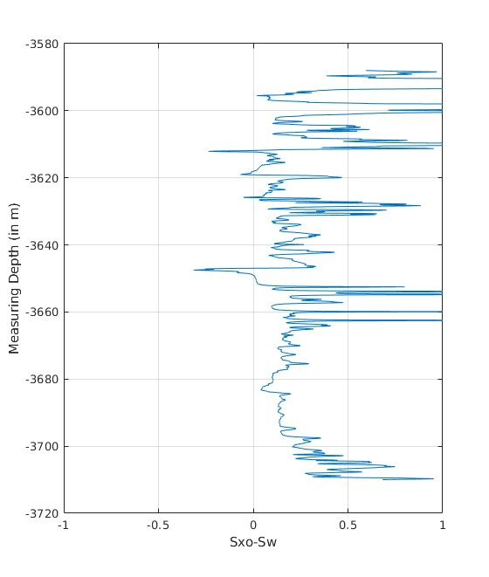
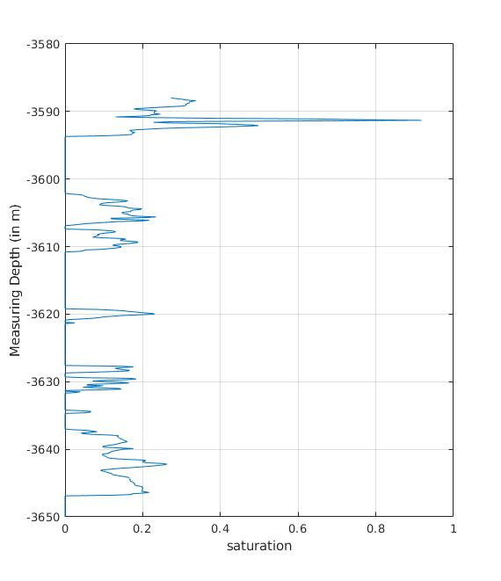
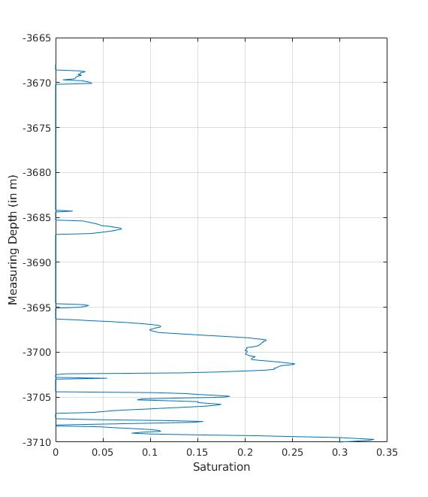
V-Shale
Permeability
Sw (3580-3650 m)
Sw (3665-3710 m)
Effective Porosity
LOOKING AT THE FORMATION “C” FOR WELL 3

Slide 18
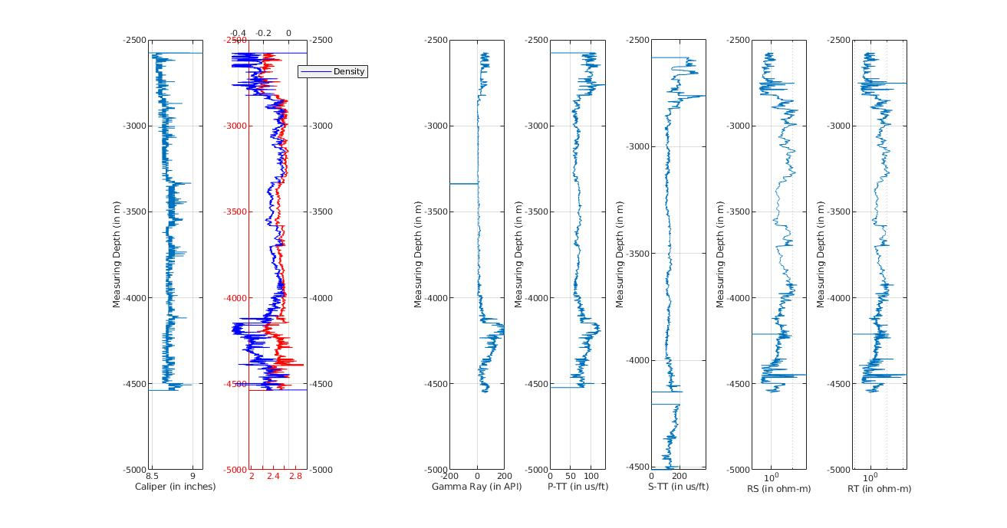
WELL “4”
DENSITY
FORMATION “A”
FORMATION“B”
FORMATION “C”
NPHI

Slide 19
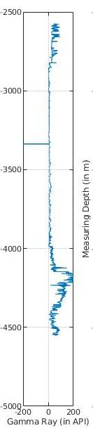
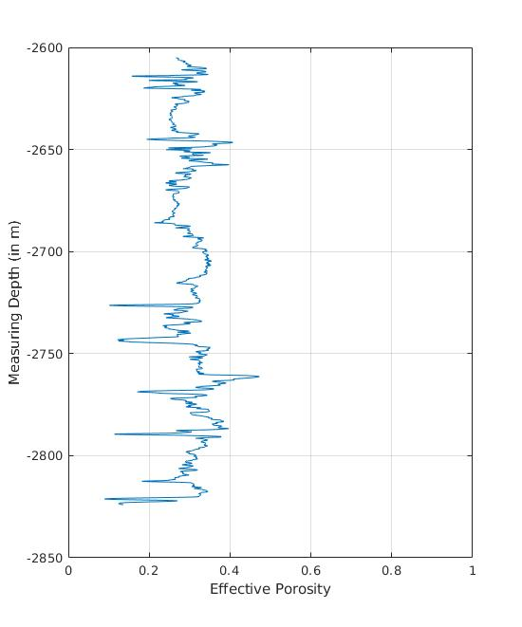
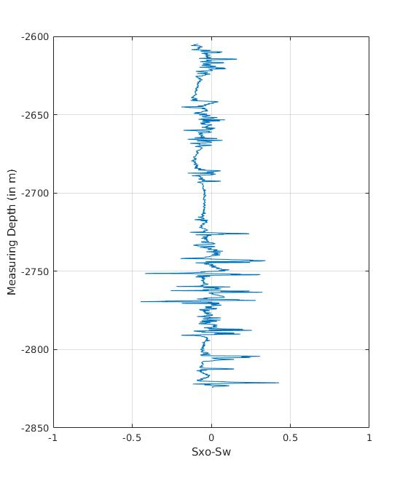
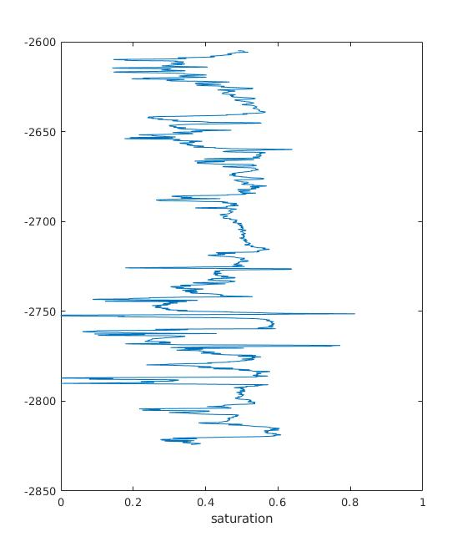
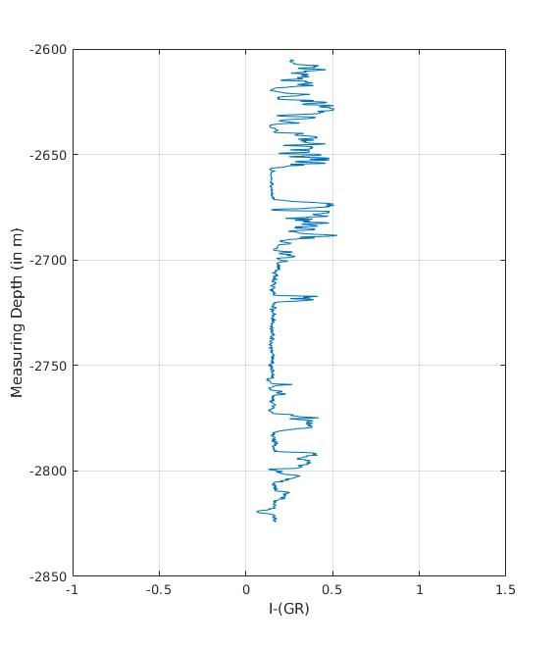
Effective Porosity
V-Shale
Permeability
Saturation
LOOKING AT THE FORMATION “A” FOR WELL 4

Slide 20
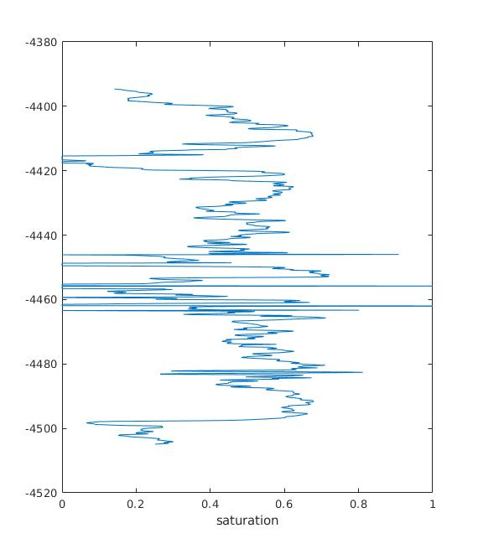
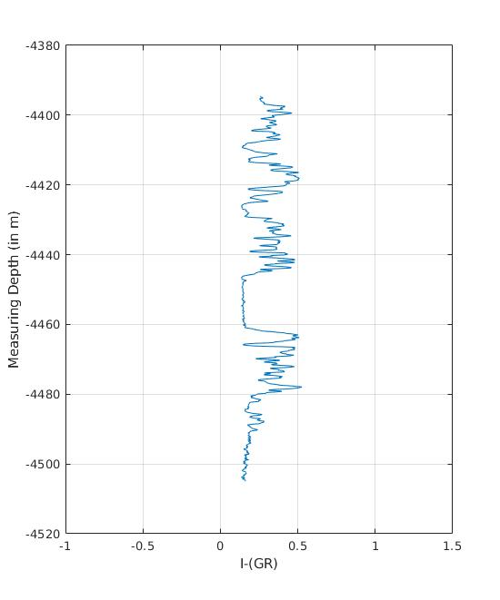
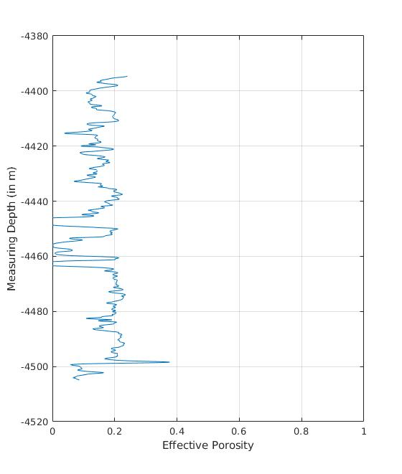
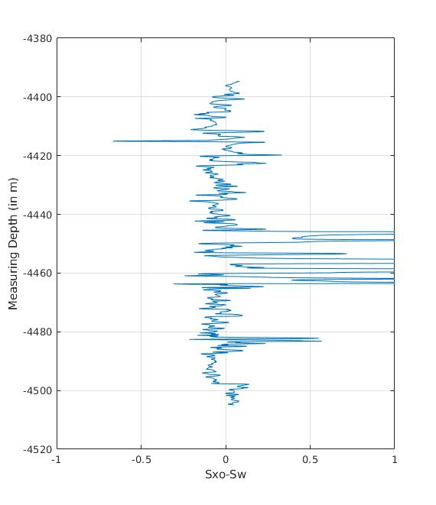
V-Shale
Effective Porosity
Sw- saturation
Permeability
LOOKING AT THE FORMATION “C” FOR WELL 4

Slide 21
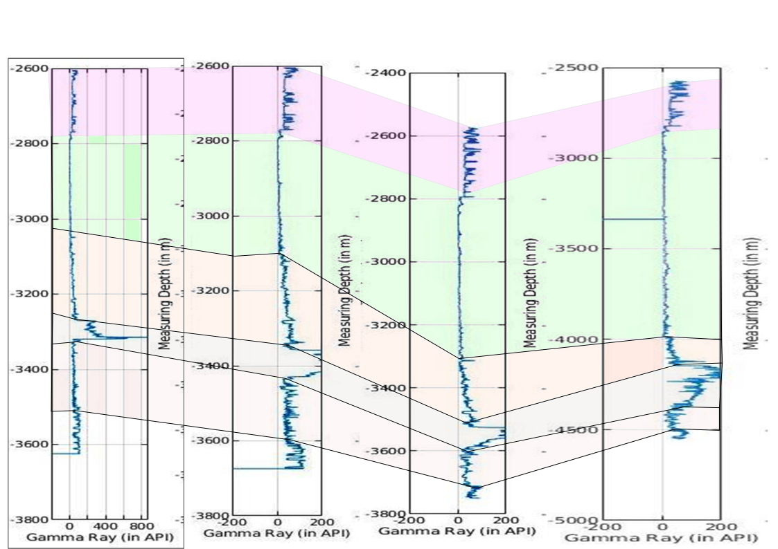
WELL CORRELATION BASED ON LITHOUNITS
WELL 1
WELL 2
WELL 3
WELL 4
Sst.-Sh. INTERCALATION
EVAPORITES
Sst.-Sh. INTERCALATION
Sst.-Sh. INTERCALATION
BLACK SHALE

Slide 22



RESULT
Where; HIIP -Hydrocarbons Initially In Place GRV - Gross Rock Volume N:G - Net to Gross phi - Porosity Sw - Saturation of water FVF - Formation Volume Factor

Slide 23

Thank you

